Slide 1
Teach reading: change lives
Parent workshop: Phonics and early reading in Year 1, Phase 5
Notes:
For this presentation, you will need to download and print out the following resources and information for parents:
the parent handout ‘Your child’s reading journey – Year 1’
‘Grow the code’ chart/mat
‘Phase 5 tricky words: Year 1 – Information for parents and carers' – or parents can access this in the ‘For parents’ area of the Little Wandle website.
You will need also need:
a flipchart
word cards to show how children spot digraphs in words; use two words with the same digraph, e.g. ‘head’ and ‘bread’
access to the Little Wandle and Collins websites
a copy of the Little Wandle Glossary (in Getting started/Teaching).

Slide 2
A love of reading is the biggest indicator of future academic success.
OECD (The Organisation for Economic Co-operation and Development)
Notes:
Slide purpose:
To share the link that research has established between loving reading and being successful academically
Suggested script:
Let's start our session with a quote from the Organisation for Economic Co-operation and Development ...
Read the quote.
This quote reminds us of the importance not just of teaching children to read, but also of teaching them to love reading.
Today, we're going to talk about phonics, but we always see phonics as the route into reading and a love of reading as the ultimate goal of phonics teaching.

Slide 3


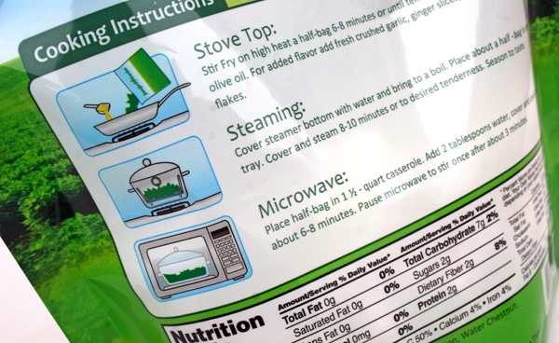
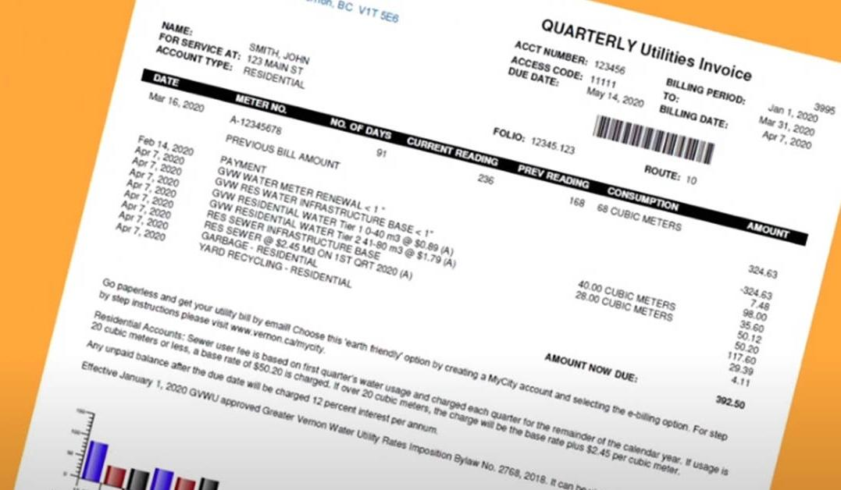
How many times have you already read today? This shows how important it is to teach our children to read.
Notes:
Slide purpose:
To help parents see the value of reading by getting them to reflect on their own reading experiences
Suggested script:
Just think about how many times you have already read things today. More than ever, we are surrounded by text and reading is a vital skill.
We want all of our children to become confident readers who can navigate the world of reading around them.

Slide 4

Phonics

Slide 5

Little Wandle Letters and Sounds Revised
Our school has chosen
Little Wandle Letters and Sounds Revised as our systematic, synthetic phonics (SSP) programme to teach early reading and spelling.
Notes:
Slide purpose:
To inform that all schools must teach phonics but explain your school's choice of SSP
Suggested script:
As you now know, the National Curriculum specifies that all schools must teach children to read using phonics starting in Reception, carrying on into Year 1.
Read the slide.

Slide 6
Phonics is:
making connections between the sounds of our spoken words and the letters that are used to write them down.
Notes:
Slide purpose:
To give a a simple definition of phonics
Suggested script:
As you will remember from last year ...
Read the slide.
It sounds complicated but it really isn’t!
Let's review some of the important words that will help you understand phonics ...

Slide 7
Terminology
Phoneme - a sound
Blend -saying the sounds in a word to read it
Grapheme - how we write the sound down
Segment- listening for sounds in a word to write it
Digraph - two letters making one sound
Adjacent consonant - two consonants next to each other et. fl gr, br, dr
Trigraph -three letters making one sound
Split digraph - a digraph split up by another letter eg. a-e - cake
Notes:
Slide purpose:
To give simple definitions of key terminology
Suggested script:
Review what each word means – use the Glossary to help.
Children will have already learned most of these terms. In Year 1, split digraphs are introduced.

Slide 8
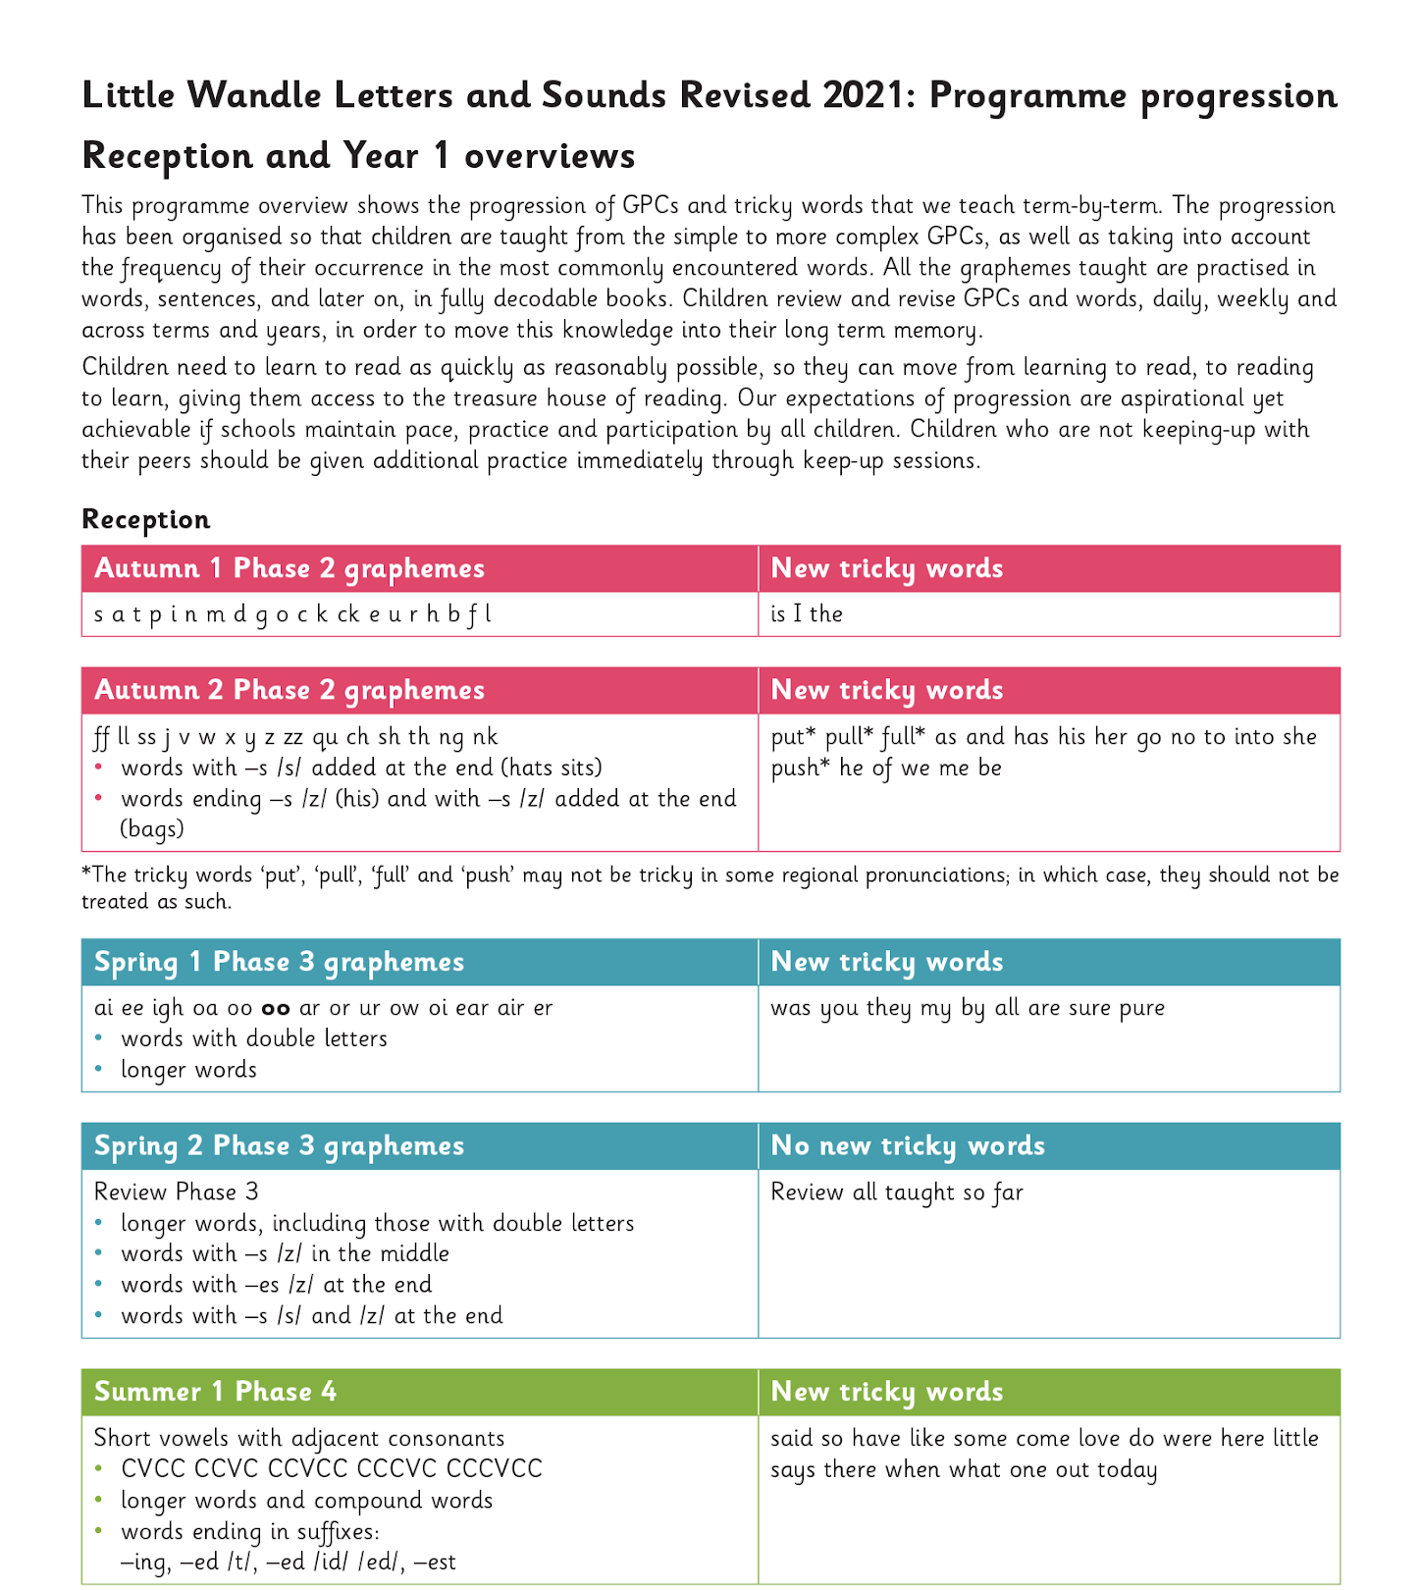
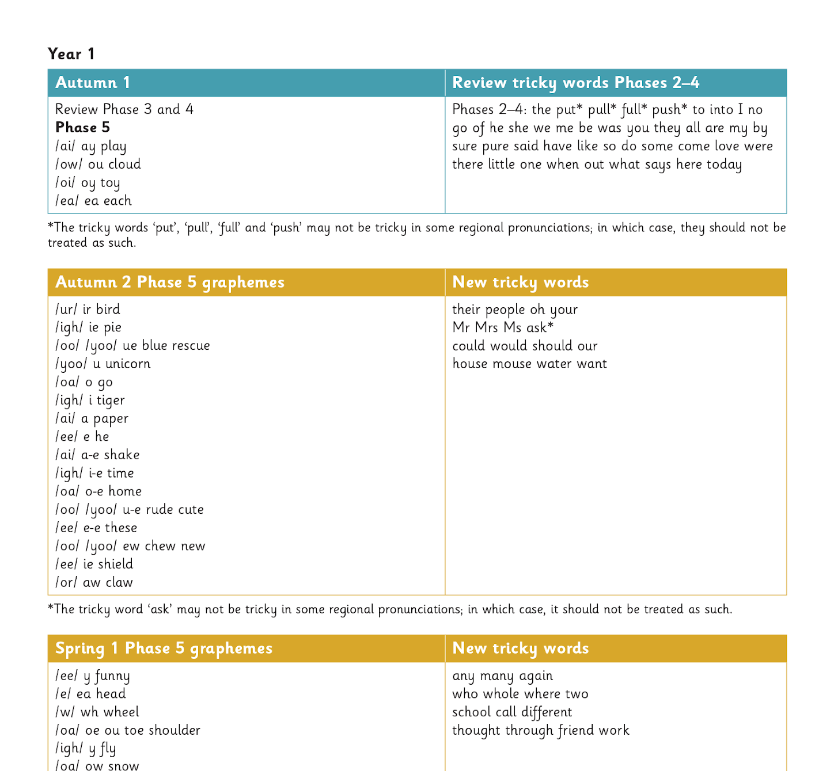
The progression - this shows what the children are taught across Reception and Year 1. Ideally the children finish Phase 5 in the Summer Term of Year 1, but some might need more support and will need to continue phonics sessions in Year 2 or KS2. You can view the whole progression on our school website.
Notes:
Slide purpose:
To provide an overview of the progression children have followed from Reception, and into Year 1
Suggested script:
Your child has learned Phases 2, 3 and 4 in Reception (seen on the left).
Now they are in Year 1, they will have a brief review of Phases 3 and 4 and all of the Reception tricky words.
By week 4 of the first half term, they will begin phase 5.
Phase 5 covers the last remaining graphemes of the Little Wandle progression and alternative pronunciations and spellings of graphemes learned.

Slide 9
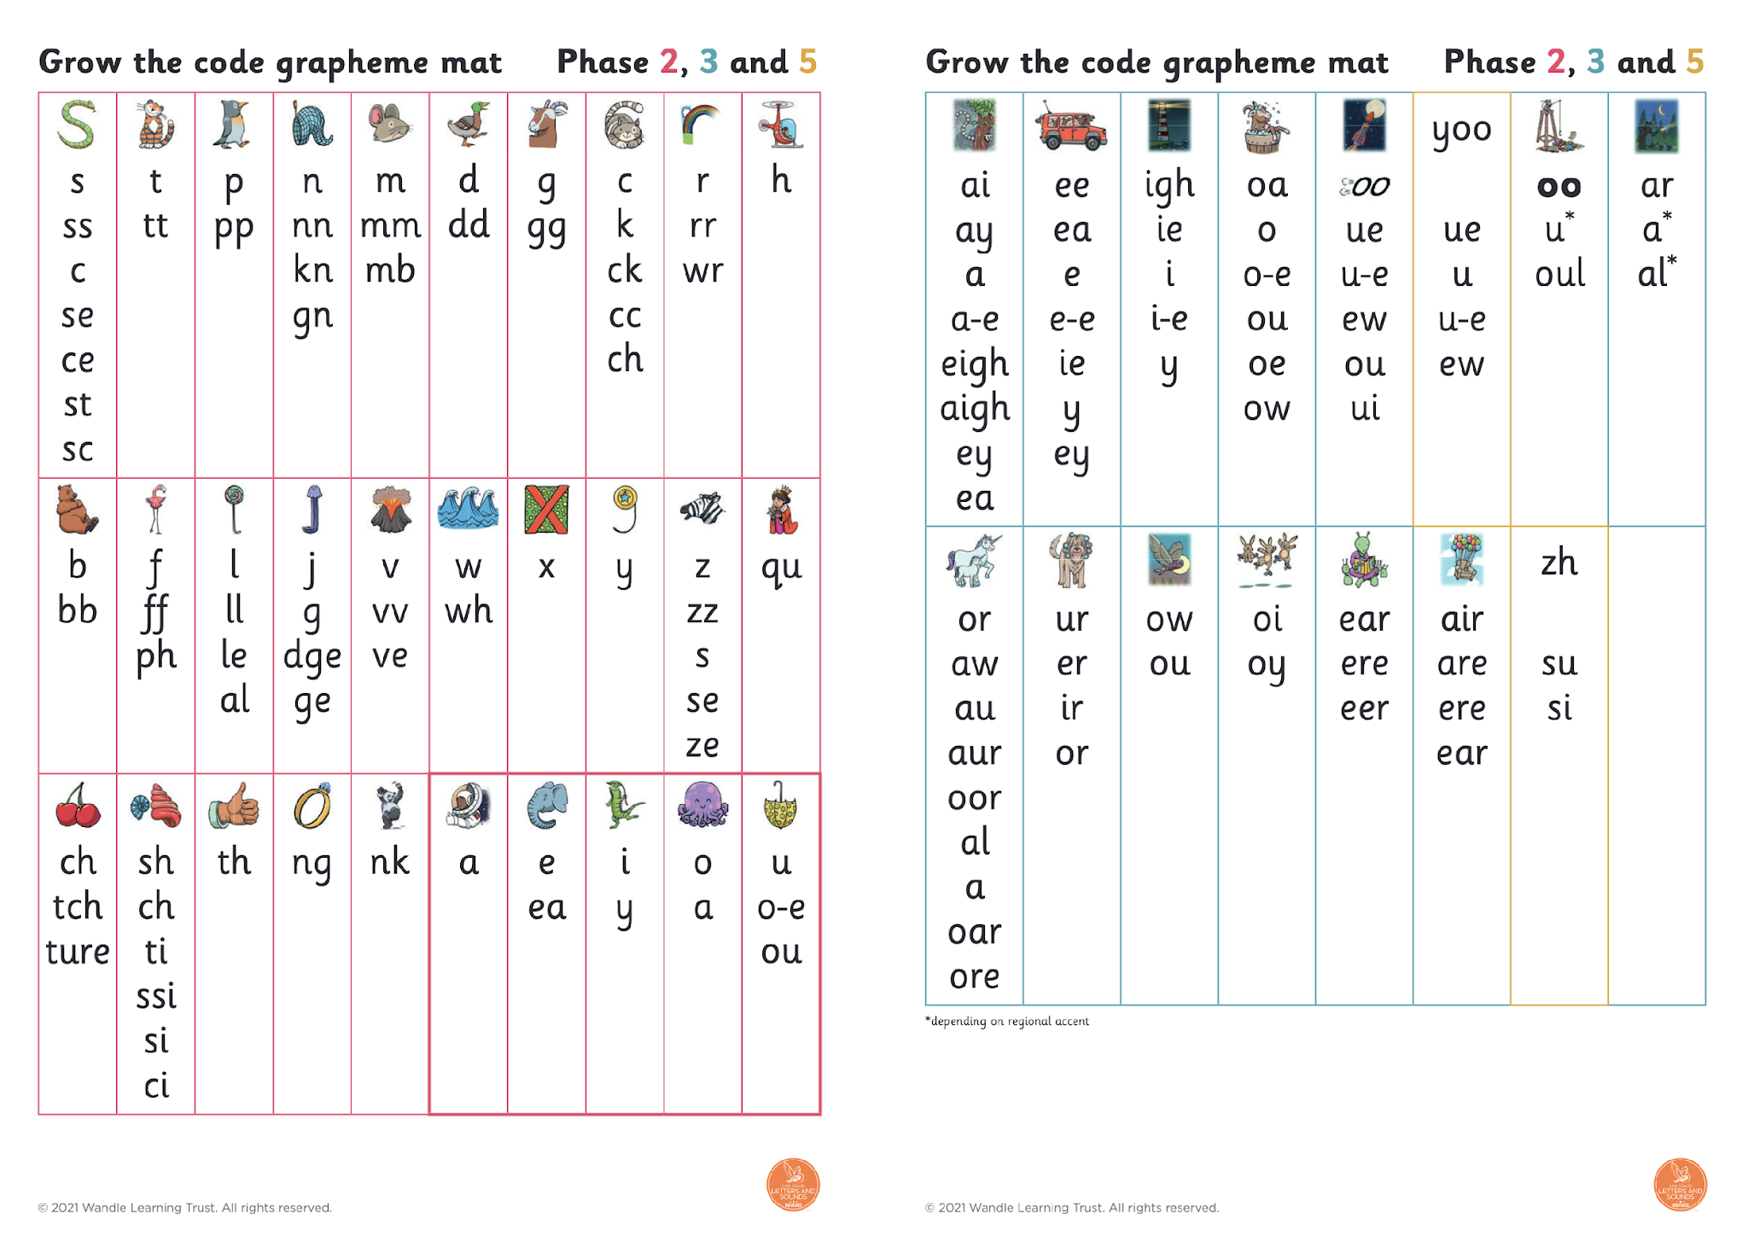
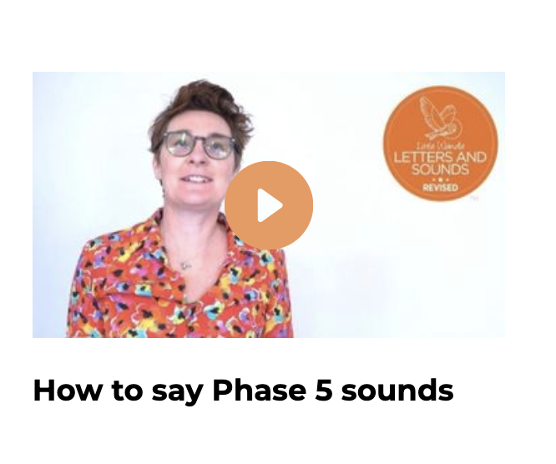
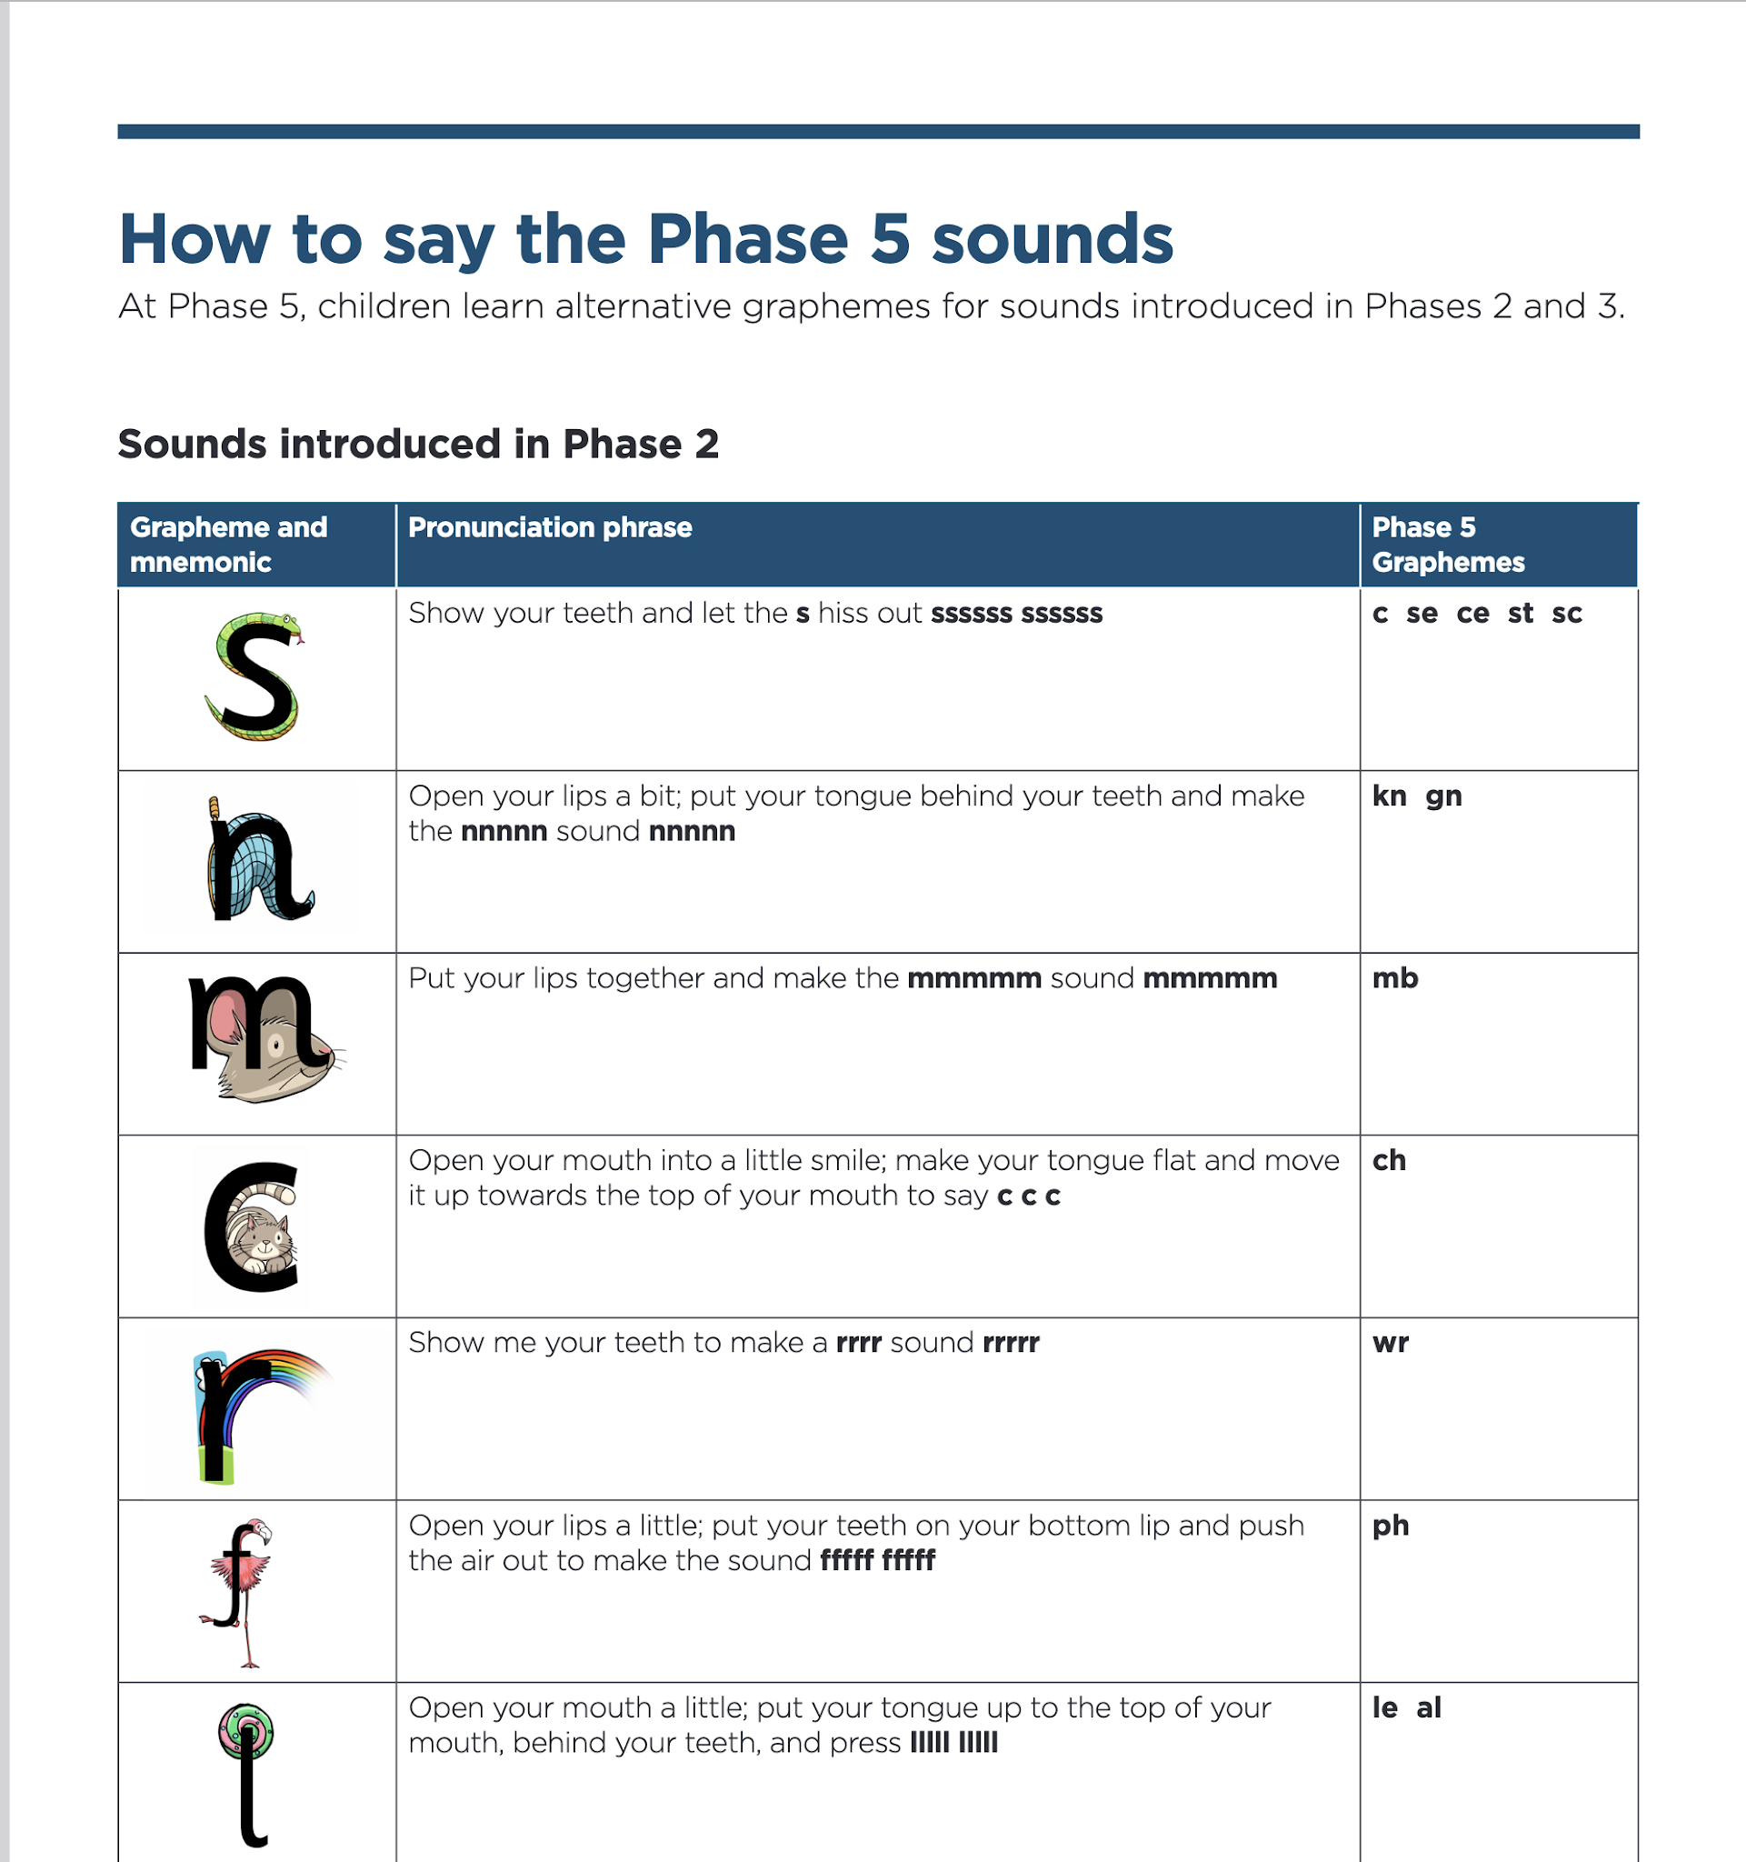
Let’s say the Phase 5 sounds - watch this on the Little Wandle website - parents section https://www.littlewandlelettersandsounds.org.uk/resources/for-parents/#tabnametabHowWeTeach
Notes:
Slide purpose:
To introduce the Phase 5 GPCs and how to say them
Suggested script:
Let's have a look at the Phase 5 sounds.
Hand out the Phase 5 handout and the ‘Grow the code’ mat.
Play the video and pause it so the parents can say the sounds if you wish.
Or display the ‘Grow the code’ chart and teach the parents the sounds.
Have a look at your handout and watch this video/look at the ‘Grow the code’ chart on the screen.
Now, let's have a practice!

Slide 10
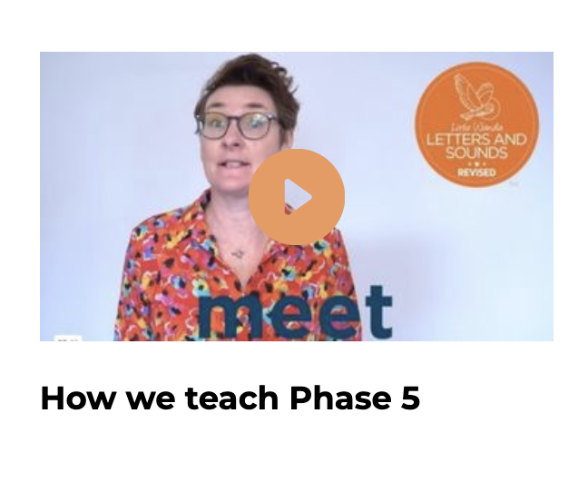
This term we are teaching Phase 5
In Phase 5 children learn:
new graphemes for the sounds they already know
that the same grapheme can have alternative pronunciations.
The ‘Grow the code’ lessons support children with reading and spelling these alternative spellings.
Notes:
Slide purpose:
To provide an overview of Phase 5 'Grow the code’
Suggested script:
The children learn the last set of graphemes, including ones with alternative pronunciations.
Play the video which explains how we teach Phase 5. (The first 20 seconds are a repeat of the ‘How to say the sounds’ video but then goes on to explain what the alternative graphemes are for the sound /ai/.)
They will also learn to ‘Grow the code’ where children will explore different ways of spelling the same phoneme and reading the same grapheme. This means that they are able to read increasingly challenging words and books.
Children learn strategies so that they can distinguish between the same grapheme, different phoneme and the same phoneme but different grapheme. ‘Growing the code’ will support children as they get older with accurate spelling.

Slide 11
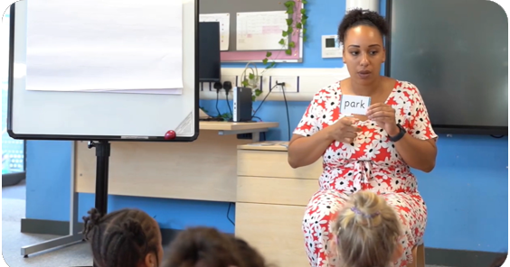
Reading words
Children will be able to:
blend independently
blend in their heads with increasing fluency and confidence.
They will also begin to distinguish between different phonemes/graphemes.
Notes:
Slide purpose:
To introduce the strategies that children need to become fluent readers
Suggested script:
Most children will now be confident using the strategy ‘blend in your head’ to build their fluency.
Blending in your head means children say the sounds quietly in their heads and then read the whole word out loud.
If your child is struggling with a word, encourage them to blend in their head.
Children are also taught to spot digraphs in words before reading the word as a whole. This also helps their developing fluency.
Show parents how to spot digraphs in words. Show a word such as ‘head’. Point to ‘ea’ and say: This is a digraph. Model reading the word: h-ea-d head. Show another word e.g. ‘bread’. Ask parents to spot the digraph and read the word: b-r-ea-d bread.
Eventually, reading becomes automatic and children will be able to read words that they know fluently.
Fluency is the ultimate goal of phonics teaching and fluent reading is explicitly taught.

Slide 12
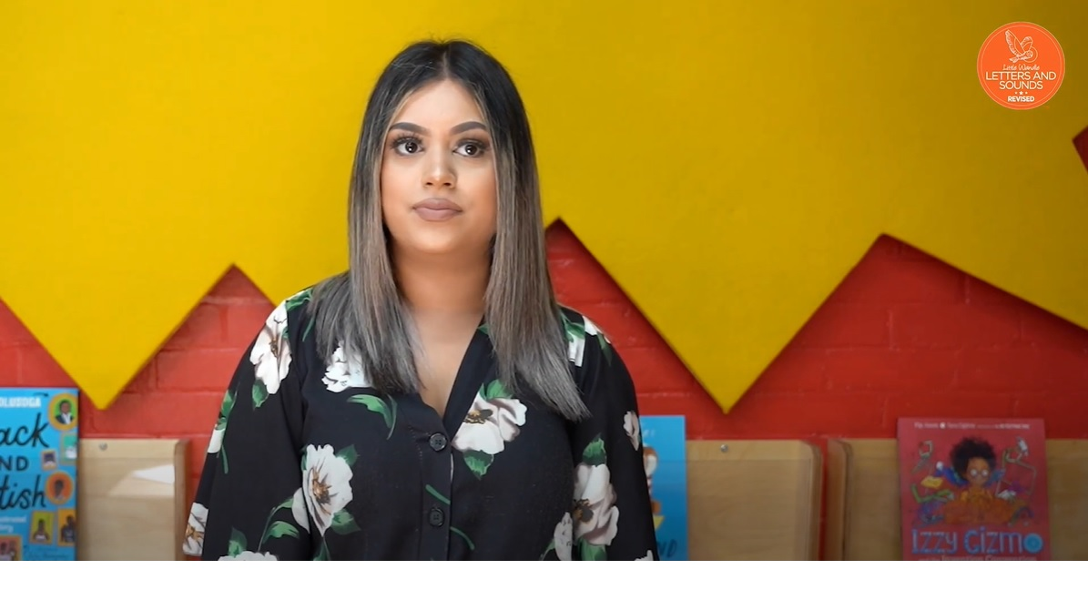
Tricky words
https://www.littlewandlelettersandsounds.org.uk/resources/for-parents/#tabnametabHowWeTeach
Notes:
Slide purpose:
To introduce tricky words
Suggested script:
So, what are tricky words?
Have a look at this video on the website: https://www.littlewandlelettersandsounds.org.uk/resources/for-parents/
It's important that children practise tricky words regularly to ensure that they can read them automatically.

Slide 13
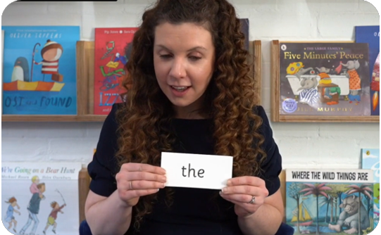
Tricky words:
have unusual spellings e.g. all, people
are taught in a systematic way.
Children are now learning to read Phase 5 tricky words.
Notes:
Slide purpose:
To provide an overview of Year 1 tricky words
Suggested script:
Tricky words have unusual spellings. For example ‘all' is tricky to children in Reception because the letter ‘a’ says /or/ in this word.
Tricky words are taught in a systematic way, following the clearly defined Little Wandle sequence of learning. We teach them because they are common words that children need to know.
As children 'Grow the code', some tricky words will no longer be tricky. For example, children learn in Year 1 that the letter ‘a’ can make the /or/ sound in words like ‘all’, ‘ball’ and ‘water’’. This means that the word ‘all’ is no longer tricky!

Slide 14
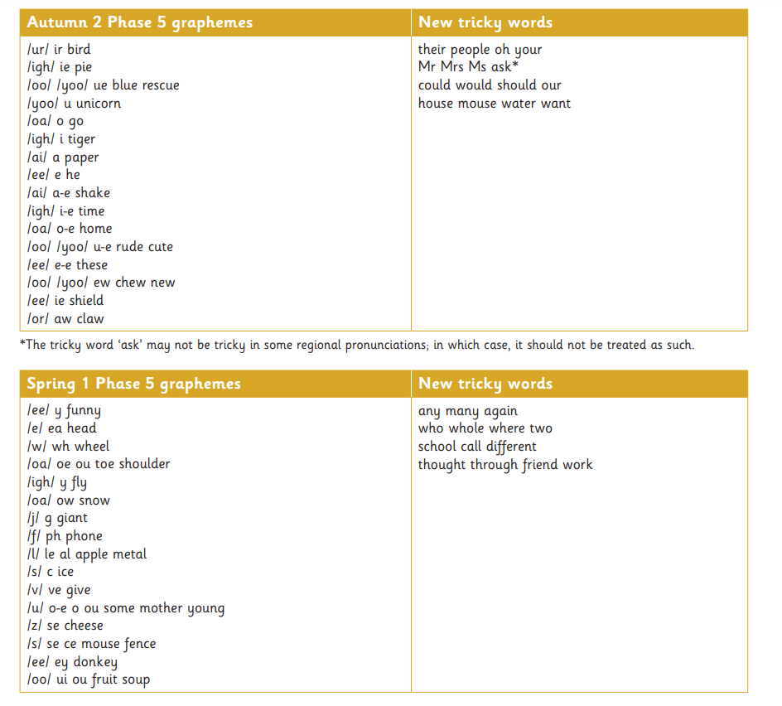
Phase 5 tricky words
Notes:
Slide purpose:
To provide an overview of Year 1 tricky words
Suggested script:
Here is an example of Year 1 tricky words.
We might not teach all of these words due to regional pronunciations e.g. ‘ask’. [Only say this if it is applicable to your setting].
You may wish to give parents a copy of the document ‘Phase 5 tricky words: Year 1 – Information for parents and carers'.

Slide 15
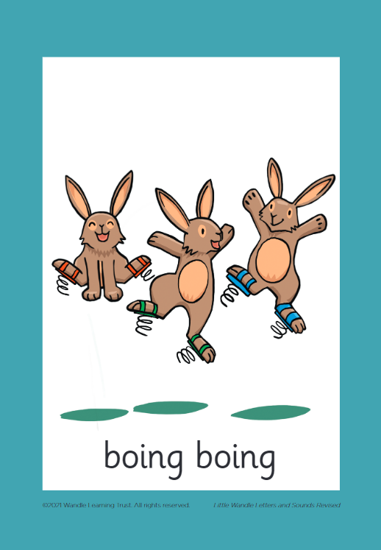



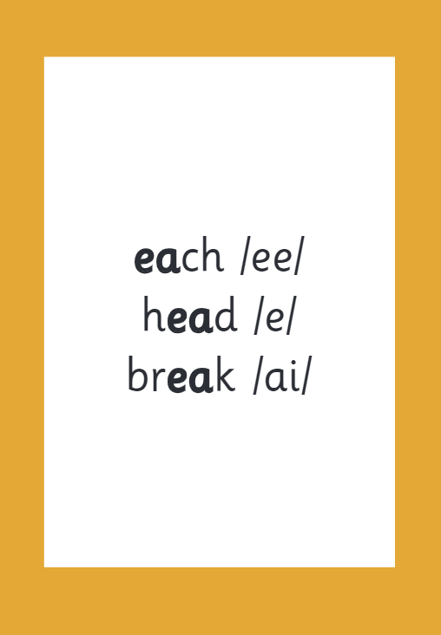

How we make learning stick - lots of repeated practice every day.
Notes:
Slide purpose:
To provide an overview of the programme’s efficacy
Suggested script:
There are specific resources for the Little Wandle programme which the children will be very familiar with.
Each sound that we teach to begin with has either a mnemonic (like the astronaut that you can see here) or a phrase like boing-boing for ‘oi’. This helps the children recognise and remember the graphemes.
Every time we teach a new sound, we also read words during the phonics lesson that contain that new sound so that the children practise what they have learned.
We then go on to reading a sentence containing some of those words.
We have displays in the classroom and on the tables to support the children throughout the day.
Your children learned all the mnemonics needed to recognise and remember graphemes in Reception. They can still use the resources in the classroom to help them with their learning. Their teacher will refer to the mnemonics learned in Reception to build on their Year 1 learning.

Slide 16
Reading and spelling

Slide 17

Spelling
This term, your child will be taught how to spell words every day using the graphemes they have been taught so far.
They will practise writing a dictated sentence.
Handwriting is referred to but is taught at other times of the day. We have handwriting sessions daily in our English lessons.
We have a weekly spelling test on a Friday. New spellings are sent home on a Friday so the children can practise their spellings each day.
Notes:
Slide purpose:
To introduce spelling
Suggested script:
In Year 1, there are increasingly challenging words to spell, e.g. longer words, compound words, plurals. This all matches the Little Wandle sequence of learning.
The children will also practise writing a dictated sentence on a Friday. Their teacher will say the sentence, show them how to write it and then ask the children to write it independently.
Handwriting phrases learned in Reception are referred to during the lesson, but the specific practice of handwriting is taught separately.

Slide 18
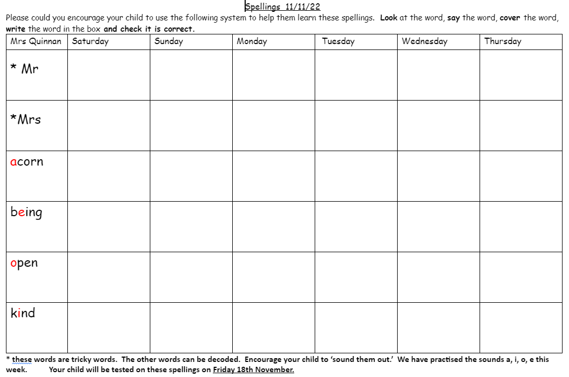
Friday spelling test - please practice everyday.

Slide 19

Spelling
Say the word.
Segment the sounds.
Count the sounds.
Write them down.
Notes:
Slide purpose:
To provide an overview of spelling
Suggested script:
Model the process above on a flipchart for the parents to see. Use a Phase 5 word, e.g. ‘play’.
If you wish to support your child at home with their spelling, this is the process to use.
There are also Phase 5 weekly spellings for additional practice, which we may use outside of phonics lessons to reinforce the children's learning.

Slide 20

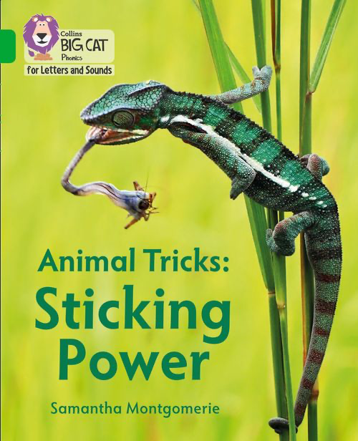

How do we teach reading in books?
Reading practice sessions are:
timetabled two or three times a week
taught by a trained teacher/teaching assistant
taught in small groups.
Notes:
Slide purpose:
To introduce decodable readers
Suggested script:
The children apply their phonic knowledge to reading a decodable book.
Books are carefully matched to children’s secure phonic knowledge.
They read the same book three times in a week.
The first time we work on decoding (sounding out) the words.
The second time we work on prosody which is reading with expression – making the book sound more interesting with our ‘storyteller voice’ or our ‘David Attenborough’ voice.
The third time we look at comprehension – understanding the text.
We read the books three times at school because we want to develop the fluency. The more children see words, the more they begin to read them automatically without having to sound them out, which is the ultimate goal.
Children’s book will then be sent home, so that they can practise their fluency further.

Slide 21




We use assessment to match your child the right level of book
Notes:
Slide purpose:
To introduce book matching
Suggested script:
We assess your child every six weeks to check progress.
Any child who needs extra support has Daily Keep-up sessions planned for them.
You will have noticed that your child’s books become more challenging as they secure more phonics.

Slide 22
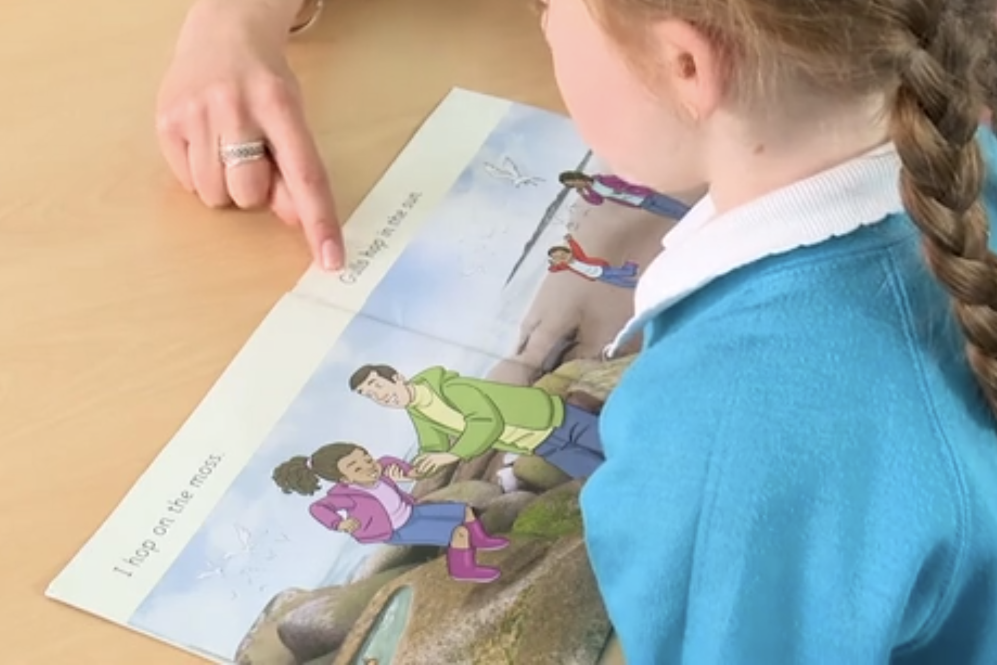
Reading a book at the right level
This means that your child should:
know all the sounds and tricky words in their phonics book well
read many of the words by silent blending (in their head) – their reading will be automatic
only need to stop and sound out about 5% of the words by the time they bring the book home – but they should be able to do this on their own.
Notes:
Slide purpose:
To provide an overview of book matching
Suggested script:
Once your child is reading a Phase 3 book, we encourage them to ‘blend in their heads’ – you will remember that this is one of the strategies we use to help develop children to become fluent readers. (Blending in your head means children say the sounds quietly in their heads and then read the whole word out loud. Eventually, this will become automatic and children can read words that they know fluently.)
We will always communicate with you if we feel that your child is not blending accurately enough yet and needs additional support.

Slide 23
Reading at home

Slide 24
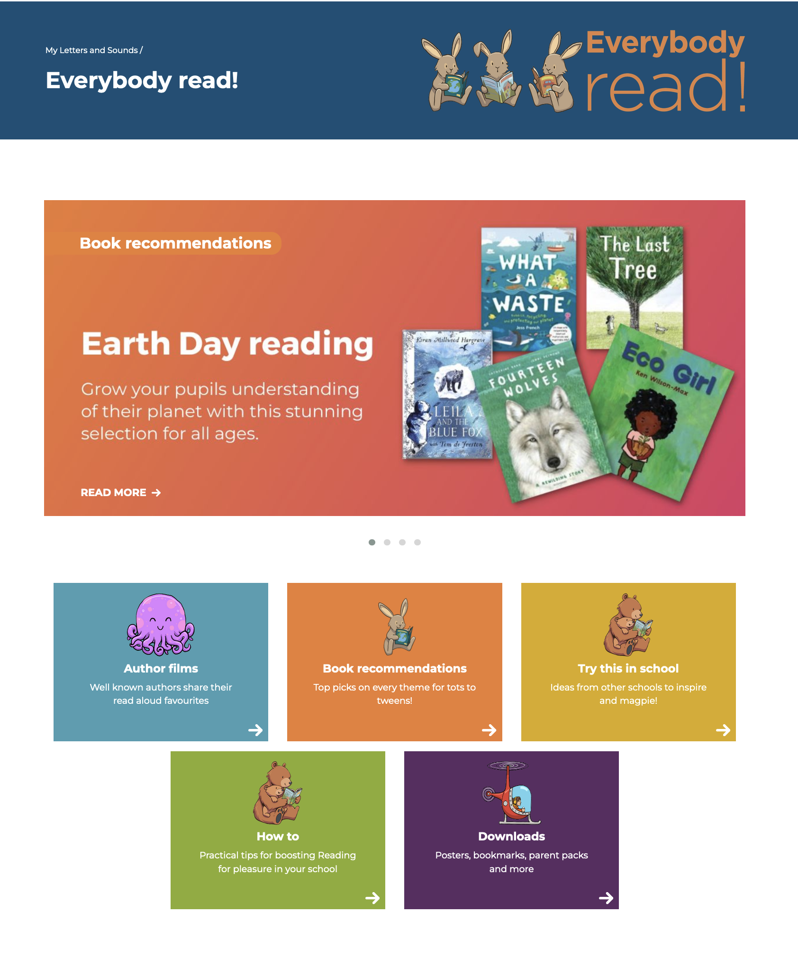
The most important thing you can do is read with your child
Reading a book and chatting had a positive impact a year later on children’s ability to…
understand words and sentences
use a wide range of vocabulary
develop listening comprehension skills.
The amount of books children were exposed to by age 6 was a positive predictor of their reading ability two years later.
Parental involvement in the development of children’s reading skills: A five-year longitudinal study (2002) Senechal, M. and Lefvre, J
Notes:
Slide purpose:
To introduce the values of reading at home
Suggested script:
You play a crucial part in your child's reading and the most important thing you can do is read with them.
Read the slide.
Celebrate your child’s success at school and make time for reading at home.
The Everybody read! part of the Little Wandle website has lots of book recommendations. Anyone can access it and find lots of lovely book recommendations for their children.
Click on link to show Everybody read! section of website: https://www.littlewandlelettersandsounds.org.uk/resources/my-letters-and-sounds/everybody-read/
Don't forget that your local library can order books for you if you really want a specific book.

Slide 25





Books going home - a reading book for your child to read to you and a library book for you to read to them.
Notes:
Slide purpose:
To summarise the format of reading at home
Suggested script:
As well as the ‘learning to read’ book that your child will bring home they will also bring home a book for sharing with you.
This book is SO important. This is how we are going to give them the WILL to read.
Please read with your child as often as you can – at least once a day if possible.

Slide 26
Listening to your child read their phonics book
Your child should be able to read their book without your help.
If they can’t read a word, read it to them or ask them to ‘sound it out’. We encourage the children to look for digraphs, trigraphs or alternate sounds.
Talk about the book and celebrate their success.
Notes:
Slide purpose:
To provide guidance on reading the decodable reader at home
Suggested script:
As already mentioned, your child will bring home their phonics book, matched to their reading ability, which they will have already read in school.
The purpose of this book is to practise their fluency.
Children shouldn’t find reading their phonics book hard! We want them to bring a book home that they can read mostly fluently.
If your child is finding a word hard to read, encourage them to sound and blend.
Communcation with us is key. Where necessary, we will always inform you of their progress and please let us know if you have any queries.

Slide 27

Read to your child
The shared book is for YOU to read:
Make the story sound as exciting as you can by changing your voice.
Talk with your child as much as you can:
  Introduce new and exciting language.
  Encourage your child to use new vocabulary.
  Make up sentences together.
  Find different words to use.
  Describe things you see.
Notes:
Slide purpose:
To provide guidance on reading the shared book at home
Only use this slide if your context allows this to be an appropriate expectation (e.g. high levels of deprivation or EAL may not be appropriate to encourage yet).
Suggested script:
Reading to your child daily can open a variety of doors to your child's education, imagination and well-being.
Read the slide.
As a school, we also prioritise reading to the children daily to encourage the love of reading.

Slide 28
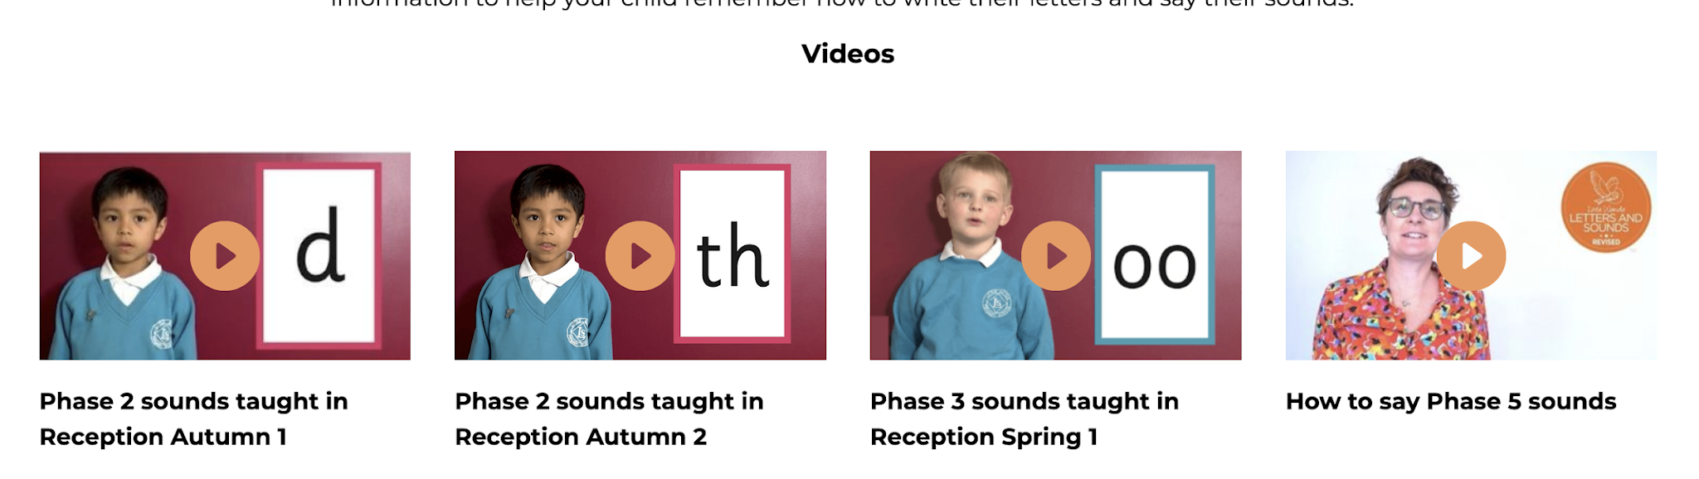
Supporting your child with phonics
https://www.littlewandlelettersandsounds.org.uk/resources/for-parents/#tabnametabHowWeTeach
The Little Wandle Website has lots of very useful information. You could also ask any one of the school staff. We would be more than happy to answer any of your questions.
Notes:
Slide purpose:
Guidance on supporting phonics learning at home
Suggested script:
It is really important that you pronounce the sounds correctly at home if you are supporting your child.
These videos are on the website for you to refer to and if you are unsure, please ask your child’s teacher.
Show the parents where to access the videos on the website and play them. https://www.littlewandlelettersandsounds.org.uk/resources/for-parents/
Tell the parents that ‘Little Wandle at Home’ phonics flashcards are available from HarperCollins: https://collins.co.uk/pages/little-wandle-at-home

Slide 29
One of the greatest gifts adults can give is to read to children
Carl Sagan
Notes:
Slide purpose:
Key takeaway/final message
Suggested script:
Read the quote.
Working together will ensure that your children become skilled readers.

